Slide 1
STENOGRAPHY IN PYTHON
CAPSTONE PROJECT
Presented By:
Student Name : Niharika S Nair
College Name & Department : Mar Baselios College of Engineering and Technology,B-Tech in Electrical and Electronics

Slide 2
OUTLINE
Problem Statement
Technology used
Wow factor
End users
Result
Conclusion
Git-hub Link
Future scope

Slide 3
PROBLEM STATEMENT
The task is to securely hide sensitive data within an image using steganography, ensuring both confidentiality and protection against unauthorized access. Unlike conventional encryption methods, which can make hidden data more apparent, steganography embeds information directly into the image's pixels, leaving the image visually unchanged. The aim is to create an effective algorithm that allows for seamless embedding and extraction of data, while preserving the image’s quality and maintaining strong security.

Slide 4
TECHNOLOGY USED
Language Used: Python
Libraries Used: Standard Libraries such as NumPy, OpenCV, OS, Tkinter, string etc.
Platforms:
Operating System: Windows 10
IDE: JetBrains PyCharm
File Format: BMP (Bitmap Image), JPEG
Additional Points:
Steganography Method: Least Significant Bit (LSB) Encoding
Data Handling: Embeds and extracts text data from images
Ability to upload image directly from the file manager without having to specify the path.

Slide 5
WOW FACTORS
Seamless Image-Based Encryption: Secret messages are securely embedded within image pixels, making the data nearly invisible to unauthorized users.
Minimal Image Distortion: Text is embedded without altering the image's visual appearance, ensuring the encrypted image looks identical to the original.
Dual-Layer Security with Passcode Protection: Even if the modified image is extracted, a passcode is required to decrypt the hidden message, adding an extra layer of security.
Efficient and Simple Algorithm: A lightweight pixel-mapping technique is used for encoding, ensuring quick and effective encryption and decryption.
Intuitive File Selection: A user-friendly GUI-based file dialog allows easy selection of images for encryption.
Cross-Format Compatibility: Supports multiple image formats (JPEG, PNG, BMP), making it adaptable for a wide range of use cases.
Automatic Image Preview After Encryption: The encrypted image opens automatically, so users can immediately confirm that the file appears unchanged.
Platform-Agnostic Functionality: Works seamlessly across different operating systems, requiring only minor adjustments (e.g., replacing os.system("start...") for macOS/Linux).

Slide 6
END USERS
Journalists & Whistleblowers
Can discreetly hide sensitive information within images to avoid detection when sharing critical reports or evidence.
Cybersecurity Professionals Ideal for training, research, and the development of techniques in digital forensics, data protection, and steganalysis.
Government & Intelligence Agencies Enables secure, covert communication and classified data transmission, ensuring secrecy without raising suspicion.
Businesses & Corporations Safeguards confidential business documents or trade secrets by embedding them within images for added security.
Privacy-Conscious Individuals Provides a way for everyday users to store private notes, passwords, or messages hidden within images.
Artists & Digital Creators Allows embedding of hidden signatures or copyrights within artwork, helping to prevent plagiarism and establish authenticity.
Researchers & Academics Serves as a valuable tool for studying data-hiding techniques, cryptography, and information security in academic research and education.
Hackathon Participants & Developers Provides a foundation for building innovative security solutions in hackathons or cybersecurity competitions.

Slide 7
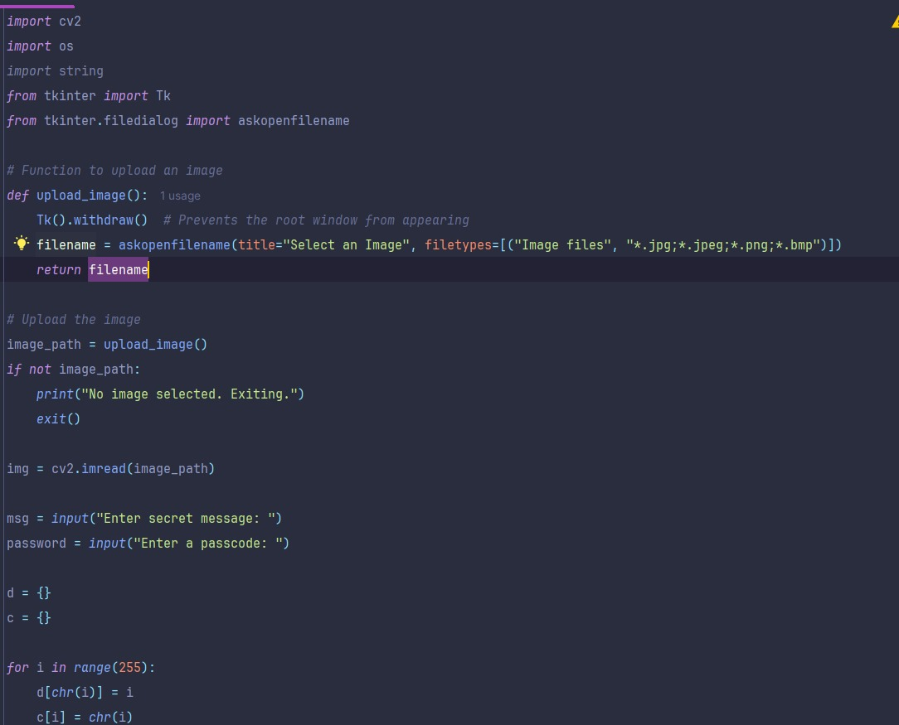
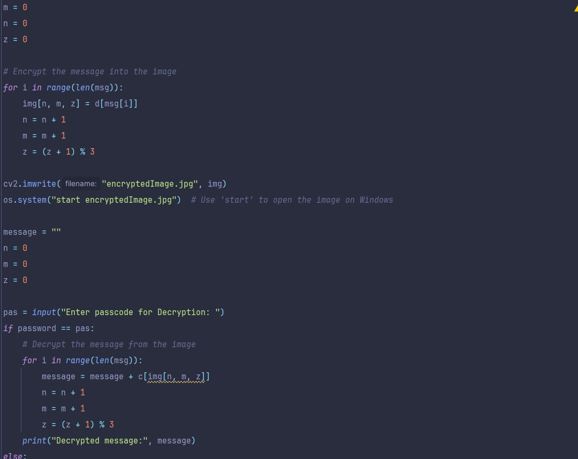
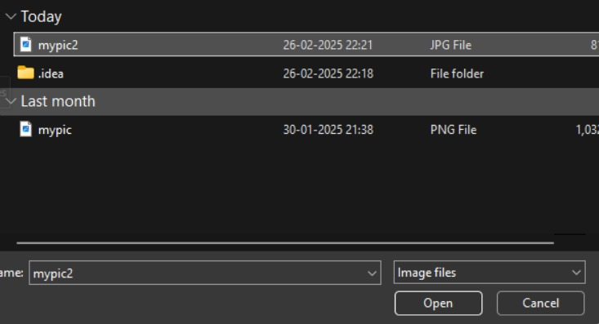
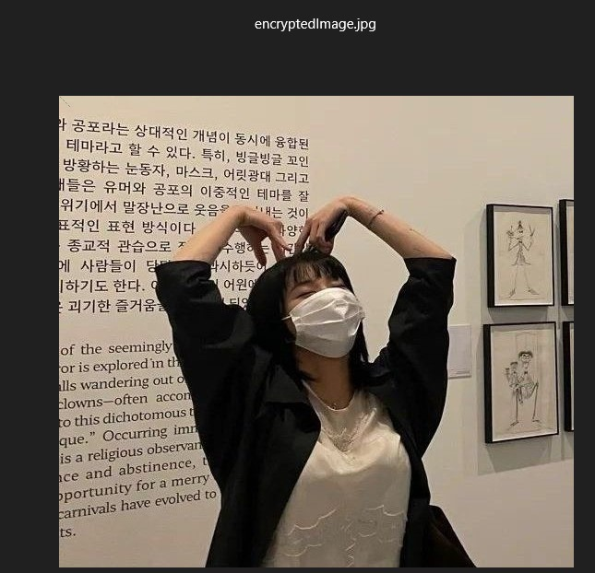
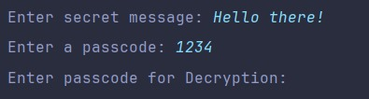

RESULTS

Slide 8
CONCLUSION
This steganography-based image encryption system offers a straightforward yet powerful method for concealing sensitive information within images, all while preserving their visual integrity. By embedding text within pixel values and securing access with a passcode, the system adds an extra layer of protection, making it ideal for confidential communication and data security.
With its user-friendly interface, cross-format compatibility, and seamless encryption-decryption process, the program is well-suited for applications in cybersecurity, journalism, corporate security, and personal privacy. Although effective for basic steganography, future improvements, such as stronger encryption algorithms, enhanced storage efficiency, and AI-driven resistance to steganalysis, could further boost its security.

Slide 9
GITHUB LINK
https://github.com/nihanair/steno

Slide 10
FUTURE SCOPE(OPTIONAL)
Enhanced Security with Advanced Encryption Incorporate AES or RSA encryption alongside steganography to provide multiple layers of protection, fortifying data security.
Advanced Image Processing Techniques Utilize methods like LSB (Least Significant Bit) substitution combined with random pixel selection to make the detection of hidden information even more difficult.
Increased Data Capacity Adopt more efficient encoding techniques, such as DCT (Discrete Cosine Transform) or Wavelet Transformation, to accommodate larger messages without noticeable distortion in the image.
Multi-Format Support & Compression Handling Broaden compatibility to include formats like GIFs and videos, while implementing strategies to minimize data loss due to image compression.
Steganalysis Resistance Develop AI-driven algorithms to combat steganalysis techniques, making it more challenging for attackers to detect hidden messages.
Real-Time Communication Integration Extend the functionality to popular messaging apps, enabling the secure exchange of encrypted images via email or chat platforms.
Blockchain Integration for Authentication Incorporate blockchain technology to authenticate steganographic messages, ensuring tamper-proof data transmission and enhancing trust.

Slide 11
THANK YOU

